Slide 1
CRICKET SCORECARD
APPLICATION

Slide 2
Problem statement :
A cricket scorecard that will show the score for a team along with score of each player.
OBJECTIVE :
To make the scorecard application easy and effective.
By using Database we can easily access the previous data(like previous matches).
Requirements:
Database – MySQL
Languages -Python

Slide 3
HOW IT WORKS:
At the execution of this python program, you can see the welcome screen displayed. The main menu that is shown along with the welcome screen has three options like new score sheet, view score sheet, and exit.
We will be given the number of players in each team the number of overs and their order of batting as a input. Then we can input overs ball by ball with the runs scored on that ball(could be wide ,no ball ,or a wicket as well).
We are expected to print individual scores, number of balls faced, number of 4’s ,6’s for all the players from batting side at the end of every over.
Print the total score, total wickets of whole team as well as individual performance. Keep tracking all the players, strike changes(at the end of over or taking singles or 3’s ) and maintain their Scores ,also keep track of extra bowls that are being bowled (like wides or no balls).
At last print which team won the match at the end.
This is the bare minimum solution which is expected for the problem. We can add some more features once you are done with these like maintaining bowlers record (total overs bowled, runs conceded, wickets taken, maiden overs, dot balls, economy etc) Total team extras, batsman strike rates etc
This code is readable and maintainable and I prefer
object oriented ,This is in modular and extensible, to add new features if needed.

Slide 4
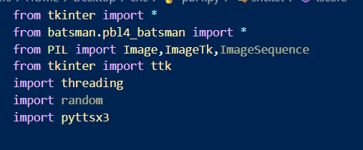
Imported modules

Slide 5
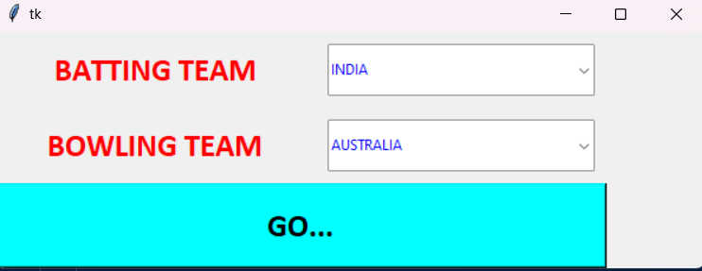
BATSMAN SELECTION

Slide 6
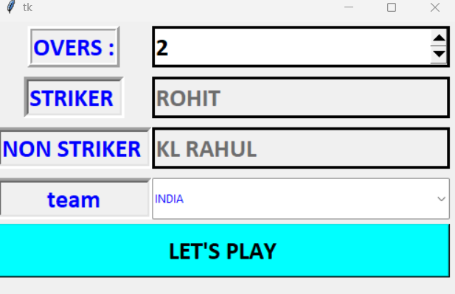
OVERS SELECTION

Slide 7
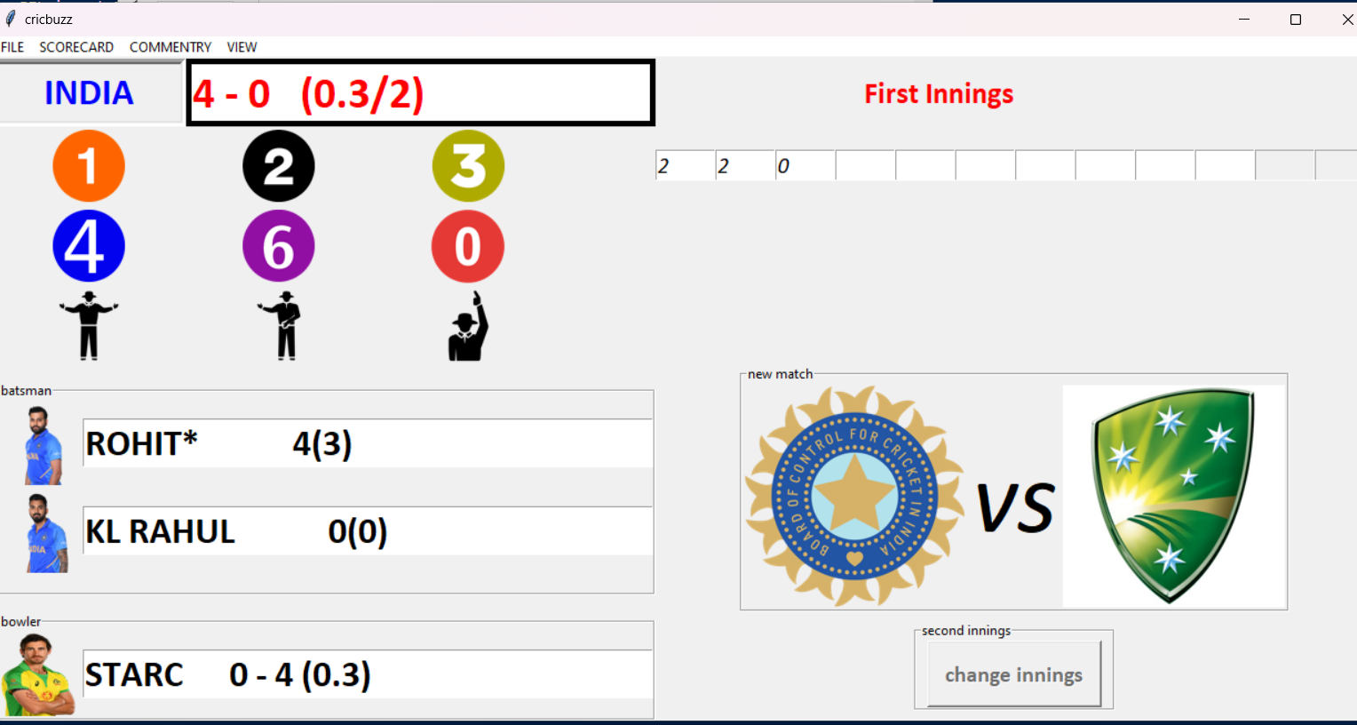
SCORECARD

Slide 8
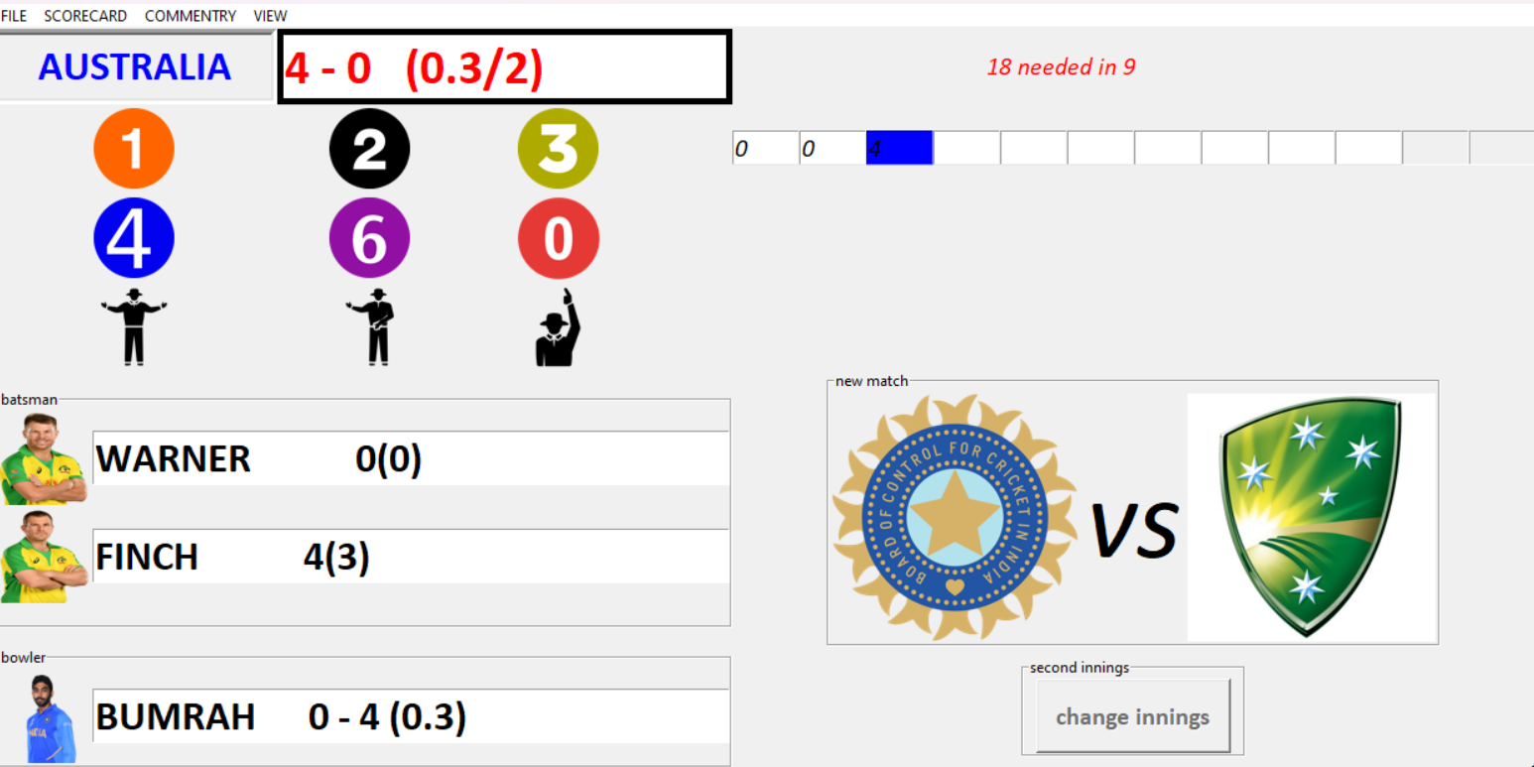
2ND INNINGS

Slide 9
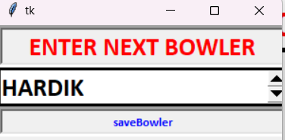
BOWLER SELECTION

